Slide 1
Microsoft Student Partners
Azure 101
MSP Kick-Off
Minsoo Bae
// Technopreneurs Innovating Tomorrow

Slide 2
Agenda of the Day
Time | Happenings
15:00 – 15:15 | Account, License
15:10 – 16:00 | Azure Portal and IaaS
16:00 – 17:00 | PaaS
// Technopreneurs Innovating Tomorrow

Slide 3
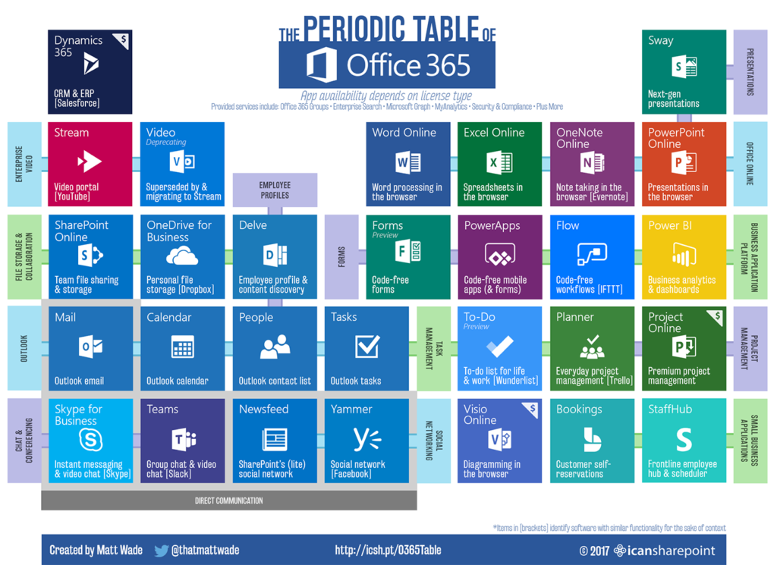
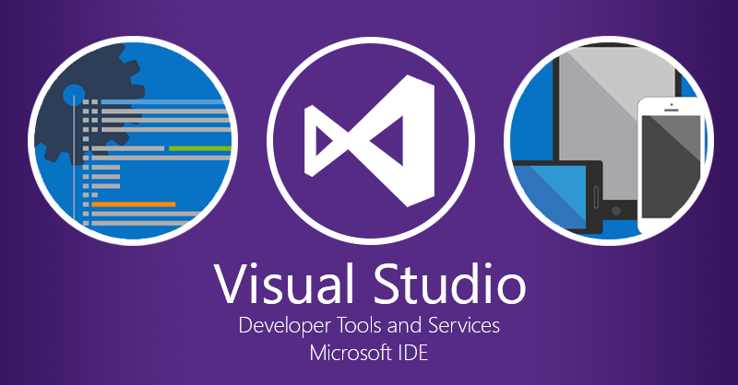
MSP benefit
// Technopreneurs Innovating Tomorrow

Slide 4
Azure 101

Slide 5
What do you think Cloud Computing is?
Cloud Computing
Notes:
Notes:
The purpose of this slide is to open discussion with the students in order to ascertain their perceptions of cloud computing.
The instructor should lead the students in exploring various perspectives of cloud computing.
Suggested ‘buzz words’ to get conversation started:
Network
Data
Services
Shared
Internet
Resources
Software
Model
Costs

Slide 6
Cloud Computing NIST Definition
Cloud computing is a model for enabling ubiquitous, convenient, on-demand network access to a shared pool of configurable computing resources (e.g., networks, servers, storage, applications, and services) that can be rapidly provisioned and released with minimal management effort or service provider interaction. This cloud model is composed of five essential characteristics, three service models, and four deployment models.
National Institute of Standards and Technology
미국 국립표준기술연구소 정의
Notes:
Notes:
In previous slides, we have reviewed various definitions of cloud computing. We conclude this exploration of perspective with the presentation of the NIST (National Institute of Standards and Technology) definition which is quite comprehensive
leads to the discussion of:
five characteristics
three service models
four deployment models
References:
http://www.nist.gov/itl/cloud/

Slide 7
Five Key Cloud Characteristics
On-demand self-service
Ubiquitous network access
Location-independent resource pooling
Rapid elasticity
Pay for what you use
Notes:
Notes:
On demand self-service:
This characteristic provides users with full control over their provisioned resources.
They should be able to power-up, increase, decrease, shutdown, or modify any other characteristics of their utilized resources without requiring assistance from the service provider.
Ubiquitous network access:
This characteristic refers to the widespread availability of broadband access to the Internet.
Further, the cloud should be accessible by various devices such as mobile phones, tablets, laptops, and workstations.
Location-independent resource pooling:
Cloud computing clients come from all over the world.
Service providers should be able to serve each of these clients equally well.
The quality of services or resources consumed by the client should not be dependent on the location of the client.
Service providers should be able to dynamically pool resources that may be geographically separated to create the illusion of a single unified service to the client.
Rapid elasticity:
The cloud service provider should be flexible in the provision of resources to meet the fluctuating demands of their customers.
Pay per use:
Expanding on the concept of utility computing, customers of cloud computing service providers are charged only for the resources they use.

Slide 8
Cloud Computing Service Models
Model | Description
Software as a Service (SaaS) | Consume it End-User Applications delivered as a service, rather than by on-premises software
Platform as a Service (PaaS) | Build on it Application platform or middleware provided as a service on which developers can build and deploy custom applications
Infrastructure as a Service (IaaS) | Migrate to it Computing, storage, or other IT infrastructure provided as a service, rather than as a dedicated capability
Notes:
Notes:
Cloud computing is delivered via three models.
IaaS (migrate to it)
PaaS (build on it)
SaaS (consume it)
Some sample companies that offer one or more of these service models are listed below. While some companies’ services are clearly specific to a particular model (MS Office 365, for example), some crossover multiple boundaries. Microsoft Azure is primarily a PaaS service model; however, its virtual machines (VMs) are IaaS services. Amazon Web Services (AWS) is primarily an IaaS service with its EC2 and S3 offerings; however, AWS has begun offering Elastic Map Reduce (EMR) with the necessary components for big data scientists and developers to develop map-reduce and Spark programs. (These concepts will be discussed in detail in later lessons.)
Sample Service Providers and Services:
Amazon
Web Services
EC2
Google
Gmail
App Engine
Cloud Storage
Microsoft
Office 365
Exchange Online
SharePoint Online
Windows Live Hotmail
Windows Azure
Salesƒorce
ƒorce.com
rackspace

Slide 9
Service Model Division of Responsibility
Infrastructure
(as a Service)
Platform
(as a Service)
Software
(as a Service)
On-Premises
Applications
Applications
User Managed
Applications
Applications
User Managed
Data
Data
Data
Data
Runtime
Runtime
Runtime
Runtime
Managed by Provider
User Managed
Middleware
Middleware
Middleware
Middleware
Managed by Provider
Operating System
Operating System
Operating System
Operating System
Managed by Provider
Virtualization
Virtualization
Virtualization
Virtualization
Servers
Servers
Servers
Servers
Storage
Storage
Storage
Storage
Networking
Networking
Networking
Networking
Notes:
Notes:
In a traditional on-premises environment, the company’s IT department manages all of the layers of the computing environment. This slides shows where the division of management of the computing layers occur in each of the cloud service models discussed.

Slide 10
Cloud Deployment Model
Hybrid Cloud
Bridge
Private Cloud
Public Cloud
Community Cloud
Notes:
Notes:
Private Cloud (also known as internal cloud):
This deployment model of cloud computing is implemented on a cloud-based secure environment and access is restricted to authorized users only.
Utilizing this model provides organizations the opportunity to control their data and establish their own security measures.
Public Cloud:
Cloud services are delivered over a network (Internet) and are open for public usage.
Community Cloud:
This deployment method represents a cloud computing model somewhere between public and private.
Setup is mutually shared between organizations with shared interest (such as banks or trading firms) and access is restricted to these organizations.
Private Access
Hybrid:
A combination of all of the above, comprising multiple servers dedicated to either private or public access.

Slide 11
Why Cloud Computing?
Pas As
You Go
Lower TCO
24x7 Support
Reliability, Scalability
Why Cloud Computing?
Device- & Location-Independent
Lower Capital Expenditure
Easy & Agile Deployment
Free Up Internal Resources
Utility Based
Highly Automated
Notes:
Notes:
Cloud computing is becoming very popular because they are flexible, reliable and cost effective. Items in this slide are categorized into one of these characteristics below:
Flexibility
Scale up and down to meet organization requirements and pay as you go
Charge for services on a fine grain level such as usage hours, Gbytes used, etc.
Easy and agile to deploy
Highly automated
Device- and location-independent
Reliability
24x7 support
Vendor responsible for hardware maintenance
Vendor responsible for software updates and maintenance for SaaS model
Cost
Reduce total cost of ownership (TCO)
Free up internal resources
Lower capital expenditure

Slide 12
Typical Computing Pattern
On and Off
Rapid Growth
Unpredictable Bursting
Predictable Bursting
Compute
Inactivity
Period
Time
Notes:
Notes:
This slide and the next three show typical computing patterns of enterprise organizations. In-house resources are often detrimentally affected by these patterns of usage. These computing patterns illustrate the advantages of organizations moving to cloud computing services to meet their IT resource requirements.
On and off workloads (e.g., batch jobs):Over-provisioned capacity is wasted. Time to market can be cumbersome.

Slide 13
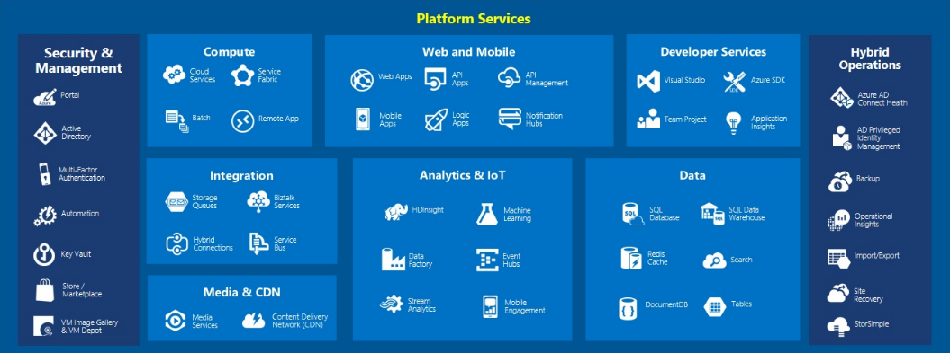
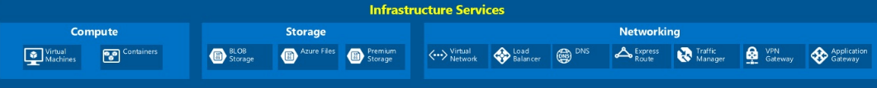
Azure Services
Notes:
Notes:
Instructors should not attempt to explain each and every service type shown on the slide. Azure services will be more fully explored in Module 1 lessons 3 and 4. This slide is a demonstration to students that the Azure services can be broken up into various categories (i.e., PaaS, IaaS, and administrative) and subcategories (i.e., Compute, Web and Mobile, Developer, etc.)
Azure is a comprehensive platform, with a smorgasbord of elements and services.
The core infrastructure services are shown at the bottom of the slide.
The middle layer offers services that are more oriented towards enterprise or private development with services to gather, massage and display data for example.
The Web and Mobile and Developer Services shown at the top are oriented more for the development of end-user software and services that can be developed, tested, and deployed under the Azure platform.
References:
Image Source: https://blogs.msdn.microsoft.com/niallsblog/2015/05/18/running-a-high-volume-website-on-azure-infrastructure-services/

Slide 14

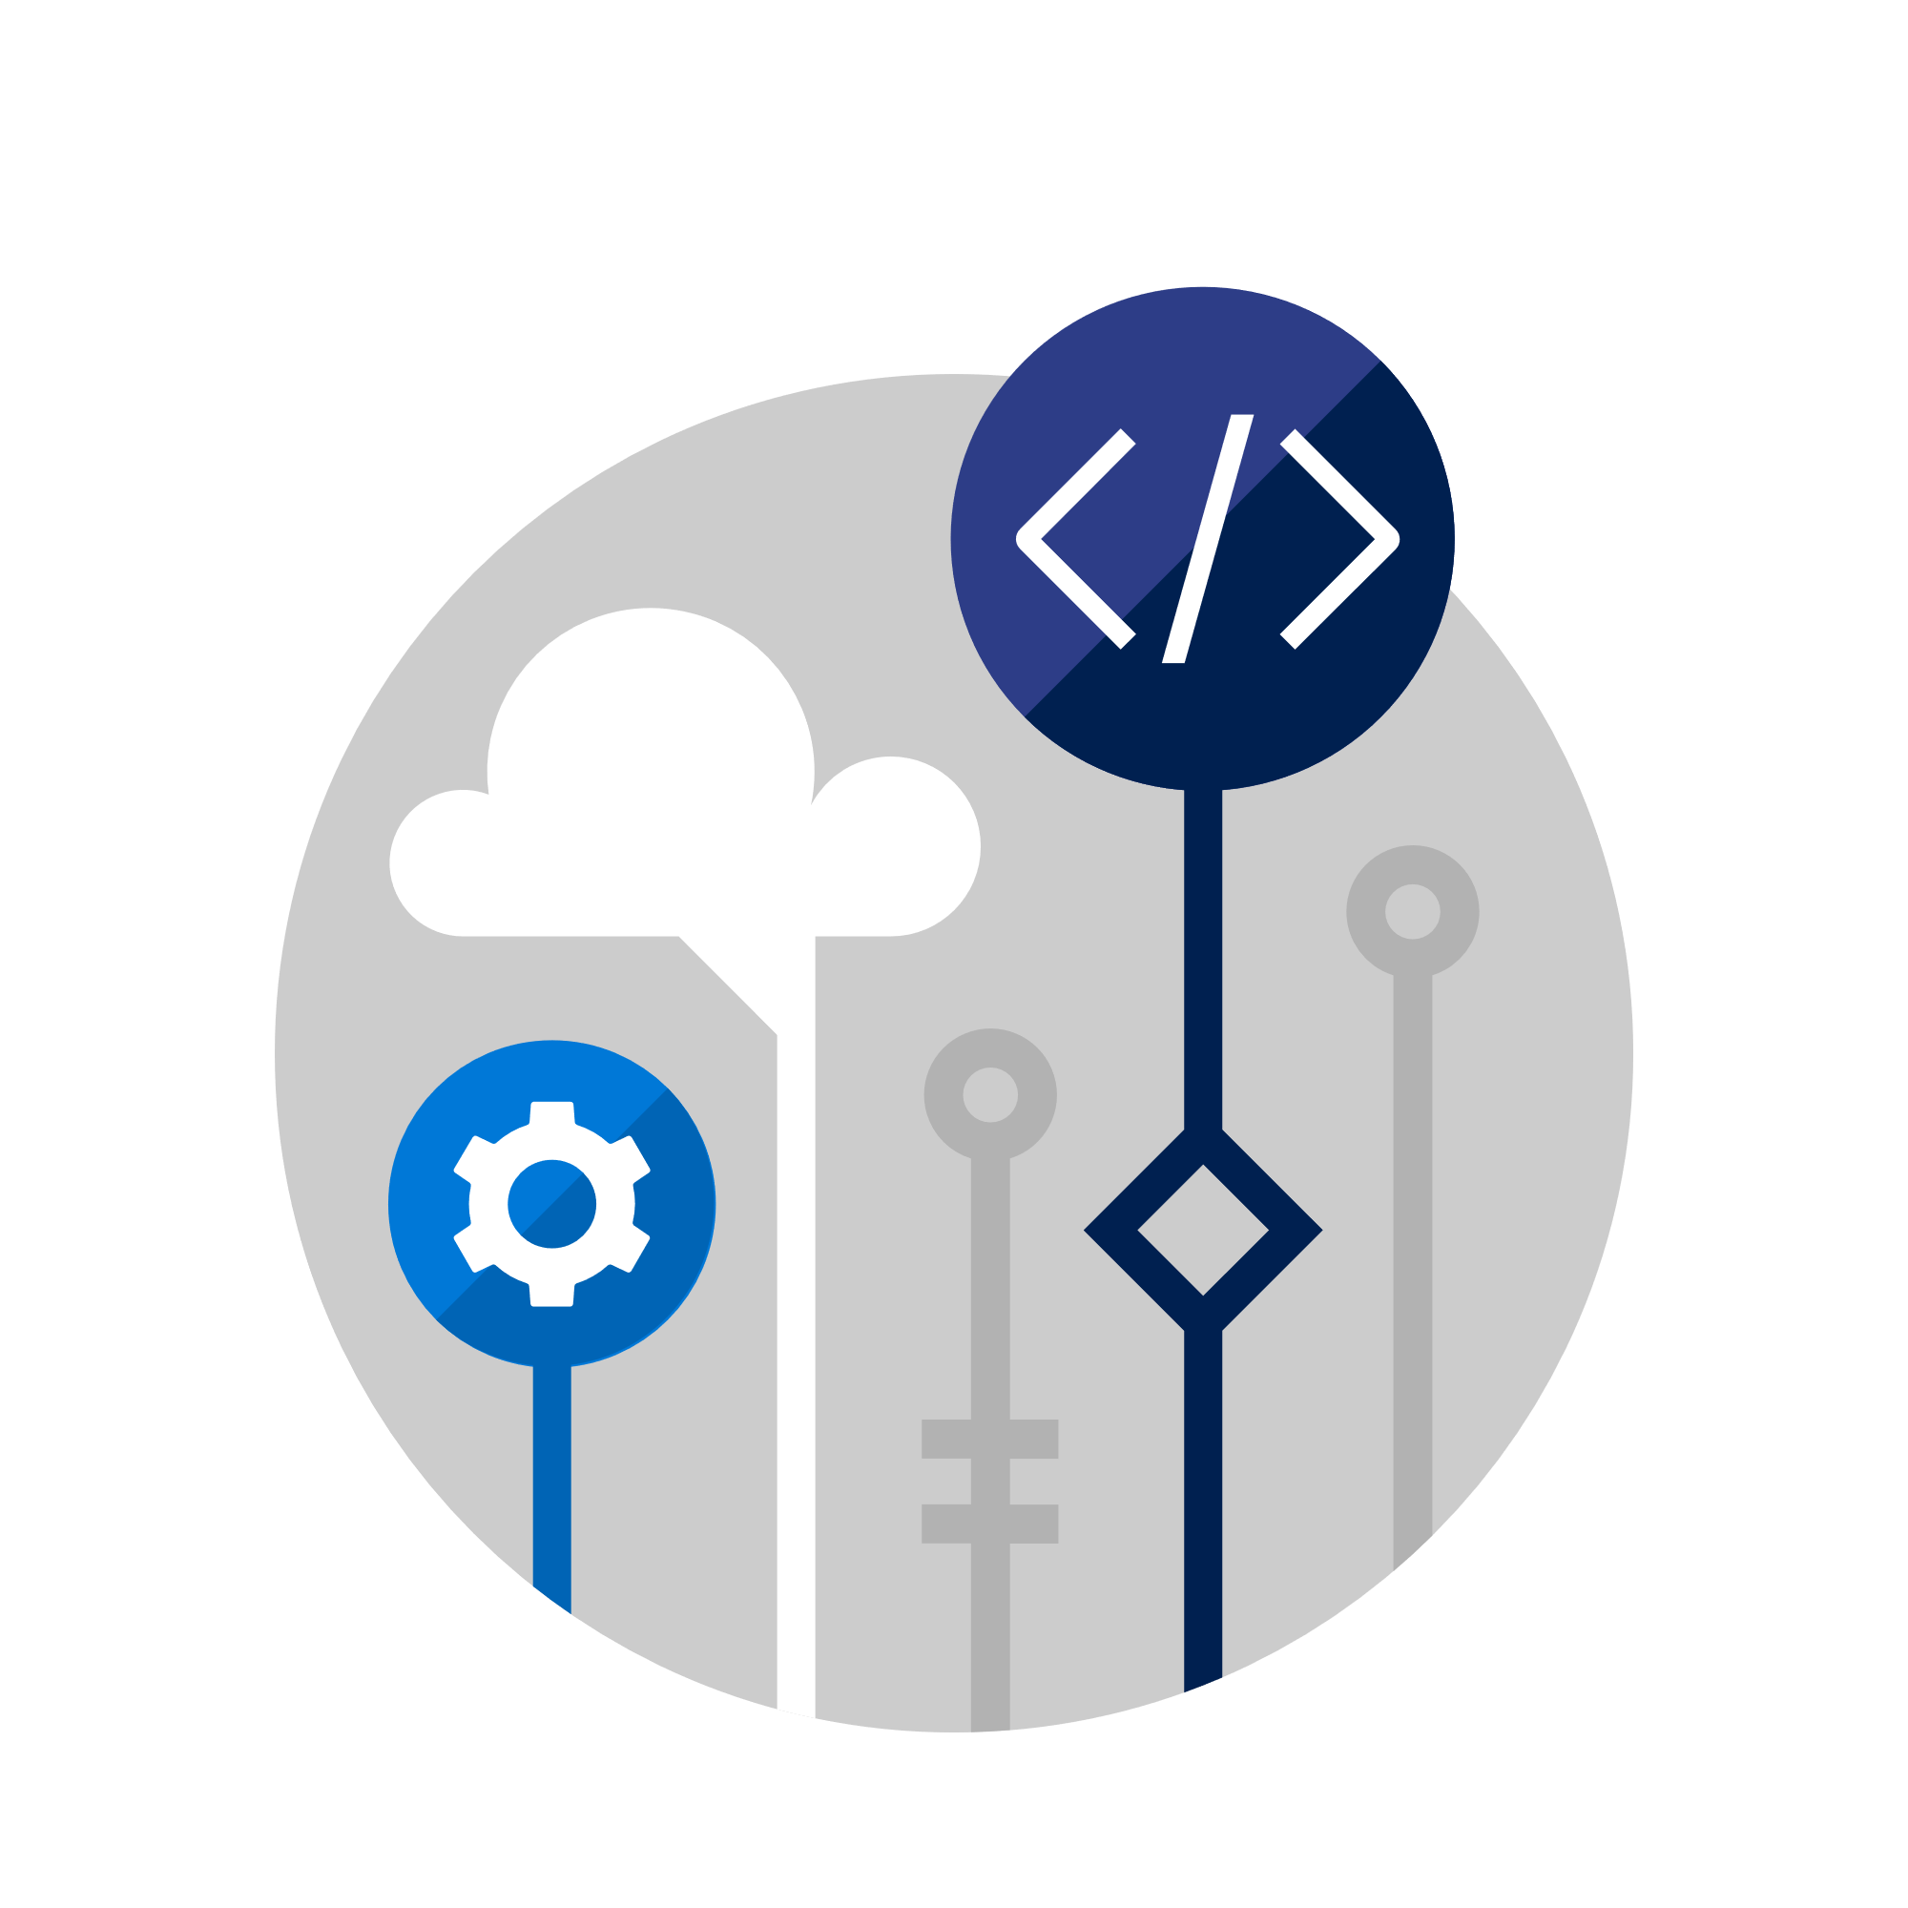



Trusted approach to AI
Universal principles
Ethical design
Open collaboration
Partnership on AI
Built on trust
Governance
Microsoft AI technologies
Microsoft AI
AI platform
Intelligent products
AI business
solutions
Notes:
The potential for the future of AI is limitless, but let’s talk about what exists today that can drive real value for you (business, consumer, society depending on audience).

Slide 15
Microsoft AI products and solutions
Microsoft AI
AI platform
Intelligent products
AI business
solutions
Cognitive Services
Azure Bot Services
AI infrastructure and tools
Machine Learning Services
Bing
Cortana
Office 365
Dynamics 365
Templates
Accelerators
Dynamics 365 Customer Support Solution
Notes:
Microsoft offers AI products and solutions across three core areas:
AI Platform: Everything you need for faster, more flexible AI innovation. Powerful tools and services that accelerate the development of AI solutions; and Azure infrastructure for virtually infinite scale.
Additional examples:
Cognitive Services
Bot Framework
Cortana Devices SDK
Cognitive Toolkit
Azure Machine Learning
Azure N Series
FPGA
Intelligent products: We’re building products with AI at their core including Bing and Cortana and infusing AI into the products that millions of people use every day, from Office 365, Dynamics 365 and more
Additional examples:
Office 365
Dynamics 365
SwiftKey
Pix
Skype
Bing
Windows photos
Cortana
AI business solutions: We’re working to create solutions for each industry and vertical—easy-to-use accelerators, templates, and custom-built solutions to empower your business.

Slide 16
AI platform
Infrastructure
Services
Tools
Notes:
With the Azure platform and productivity services, you can create the next generation of applications that span an intelligent cloud and an intelligent edge powered by AI.

Slide 17
AI platform
Infrastructure
FPGA
Virtually infinite data and compute capabilities for any AI scenario
FPGA
CPU
GPU
Services
Tools
Notes:
Infrastructure: Microsoft provides a variety of services and tools, backed by a best-of-breed infrastructure with enterprise grade security, availability, compliance and manageability, for developers and data scientists to build and deploy AI-infused applications. Developers can harness the power of Azure’s infinite scale infrastructure and use integrated services to incorporate AI on their data platforms, such as Azure DataLake and Cosmos DB. All of these tools run on Microsoft’s Azure cloud computing platform, which now spans 36 regions around the world and provides the backbone for many customers who are developing and running AI-infused products and services.
Microsoft also is incorporating reprogrammable computer chips called Field Programmable Gateway Arrays (FPGAs) into Azure, as part of a long-term effort to build an AI supercomputer in the cloud. FPGAs make computing in the cloud faster and more efficient because you can write algorithms directly onto the hardware, instead of using potentially less efficient software as the middle man.

Slide 18
AI platform
Infrastructure
Services
Powerful and flexible services accelerate development of intelligent apps
Cognitive Services
Azure Bot Service
Machine Learning
Tools
Notes:
Services: Think of these as the building blocks of AI. We have the most comprehensive set of AI services, and they can be infused into applications with just a few lines of code. More than 760,000 developers from 60 countries are using Cognitive Services to build apps that do things like recognize gestures, convert speech into text or identify, caption and moderate images.
In addition, more than 240,000 developers have signed up to use Azure Bot Service to create bots that can interact naturally with customers on websites and in apps.
Microsoft also uses bots to help its own users, in products such as Microsoft Teams and Skype. There are also more than 100 million people interacting with our own social chatbots, including XiaoIce in China, Rinna in Japan and Zo in the United States. XiaoIce has become so popular that she’s even hosting a morning news program and has written a highly acclaimed book of poetry.

Slide 19
AI platform
Infrastructure
Services
Tools
Comprehensive and productive tooling for AI coding and management
Notes:
Tools: We provide developers with a rich set of tools to simplify development, such as Visual Studio Code Tools for AI. We also make the Microsoft Cognitive Toolkit — which is used across Microsoft to achieve breakthroughs in artificial intelligence using deep learning – freely available to the public via an open-source license.

Slide 20
Microsoft’s Ambitions
Create more personal computing
AI
Build the intelligent cloud platform
Democratize AI
Reinvent productivity & business processes
Notes:
We have three interconnected ambitions: build an intelligent cloud platform, create more personal computing, and reinvent productivity and business processes. Each of these helps to overcome barriers to human progress, such as time, place and complexity.
Perhaps our greatest barrier is that of information. We live in a world of information abundance, where every walk of life has changed because of access to and distribution of knowledge, and yet we are often constrained by our limited capacity to absorb it.
This is where AI comes in to play—we see it at the confluence of our ambitions.

Slide 21

True to Microsoft’s mission
Empower every person
and every organization on the planet to achieve more
Notes:
[optional slide]
AI is a key enabler in helping us realize our mission as a company—to empower every person and organization on the planet to achieve more. This is why we will continue to invest in AI and democratize AI-- because we believe everyone should have access to the benefits of AI.
[optional Microsoft’s Ambitions slide in appendix]

Slide 22
Trusted approach to AI
Universal principles
Ethical design
Open collaboration
Partnership on AI
Built on trust
Governance
IaaS
Virtual machine and etc
Microsoft AI
AI platform
Intelligent products
AI business
solutions
Notes:
The potential for the future of AI is limitless, but let’s talk about what exists today that can drive real value for you (business, consumer, society depending on audience).

Slide 23
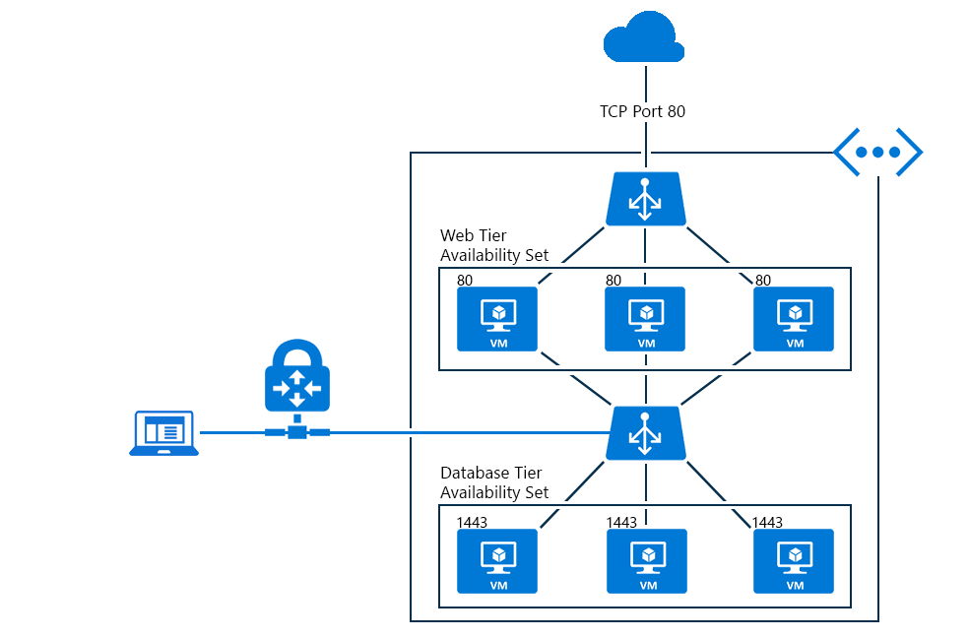
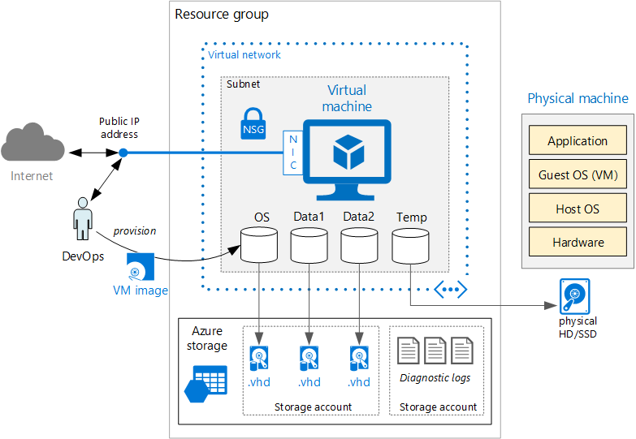
Basic Architecture

Slide 24
1. Single VM 2. VMs with Load Balancer 3. Data Science VM

Slide 25
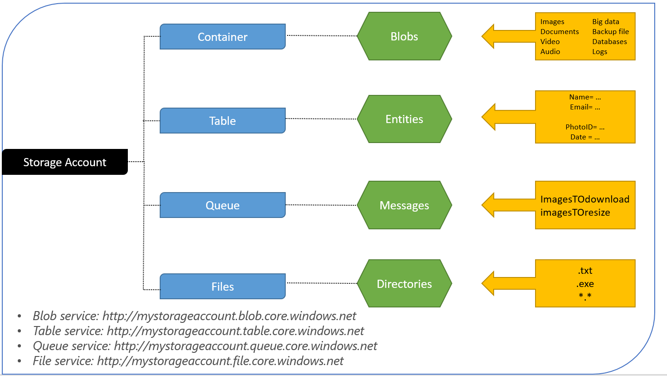
Storage Account

Slide 26
Trusted approach to AI
Universal principles
Ethical design
Open collaboration
Partnership on AI
Built on trust
Governance
PaaS
Web App
Microsoft AI
AI platform
Intelligent products
AI business
solutions
Notes:
The potential for the future of AI is limitless, but let’s talk about what exists today that can drive real value for you (business, consumer, society depending on audience).

Slide 27
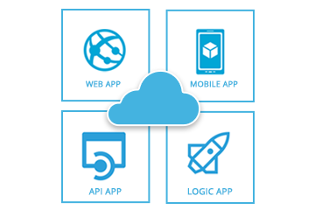
Azure Web App

Slide 28
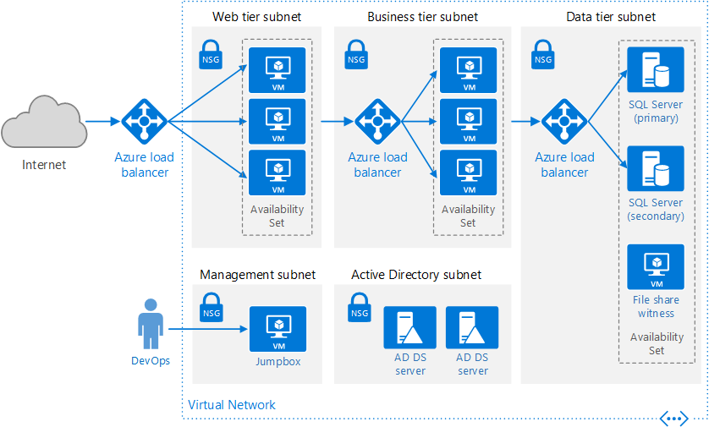
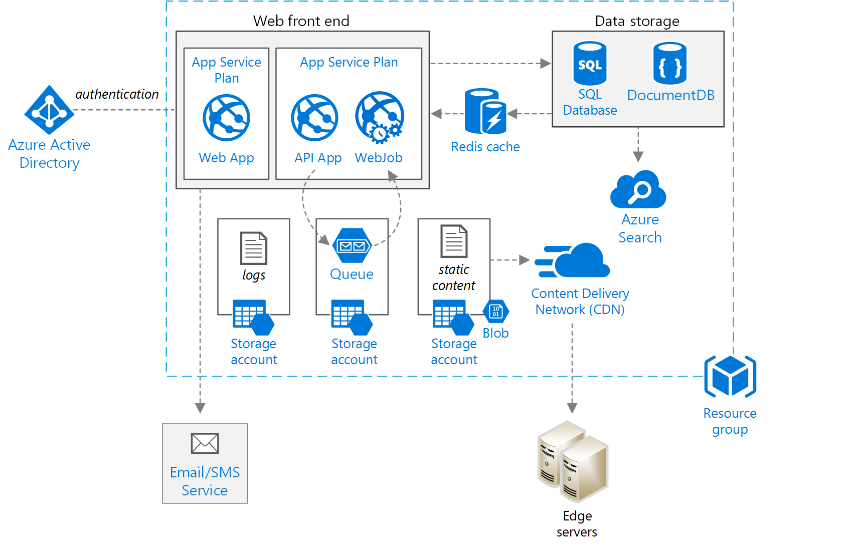
IaaS vs PaaS

Slide 29
1. Create Web App 2. Deploy Flask Hello World via Local Git 3. Online editor
Tutorial
https://docs.microsoft.com/ko-kr/azure/app-service/app-service-web-get-started-python

Slide 30
// Technopreneurs Innovating Tomorrow

Slide 31
Your Purpose, Your Goal
// Technopreneurs Innovating Tomorrow

Slide 32
Master Timeline
Dec - Jan
Jan - March
March - Beyond
Explore
Develop & Challenge
Intensive Technical Training
Self-paced Learning
Entrepreneurship Skill Set Building
Technical skills Certification
MSP Tutored Workshop for Peers
Imagine Events
Imagine Cup
Mini Technical Projects
Microsoft Partner Events
Enriching Learning
MSP Plan & Recruit | Class of 2019
// Technopreneurs Innovating Tomorrow

